Slide 1

Cyber Girls 4 . 0 Open Day Project
PRIVILEGED ACCOUNT COMPROMISE RESPONSE
Group Number: 16
Names:
1. Comfort Ukangwobia
2. Oghenetejiri Brume
3. Chinwe Domitila Ayiba
4. Gift David Dappa
5. Precious Sunday

Slide 2

Introduction
Overview:
Maintaining trust and meeting regulatory requirements is crucial to protect confidential information and systems against cyber-attacks. Apex Capital’s incident response plan aims to quickly and effectively contain cyber threats while ensuring normal business operations. This involves protecting privileged accounts and requires the collaboration of various departments. The plan will be updated regularly to reflect organizational changes, compliance culture and new technologies, and regular.

Slide 3

Introduction
Aim: To develop an effective privilege account compromise plan
Objective:
To establish a comprehensive response plan for privileged account compromise, focusing on detecting, containing, and remediating various attack methods to minimize security risks.

Slide 4
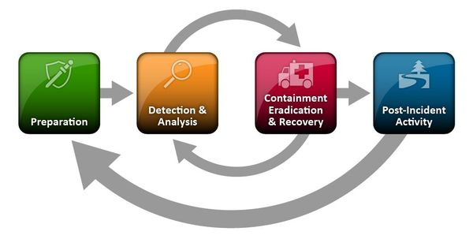
Privilege account compromise plan and procedures

Slide 5

Privilege account compromise plan and procedures
PREPARATION:
Determine the Members of the Cybersecurity Incident Response Team (CSIRT)
Define Escalation Paths
Ensure Appropriate Logging Levels

Slide 6

Privilege account compromise plan and procedures
DETECTION AND ANALYSIS:
Outline how the team initially discovered the attack.
Identify the access point and the source of the attack.
Apply the information from the method of compromise to identify the sensitive data that the attacker could have accessed.
Evaluate Apex Capital's information assets list to identify any potentially compromised assets, and make note of their integrity and any gathered evidence.
Apply various tools and methods to monitor the network and system activity, such as intrusion detection systems (IDS), log analysis, firewall rules, and alerts.
Query Apex Capital’s email system, consider inputting details such as the email subject name, document name, document hash, URL from the email.

Slide 7

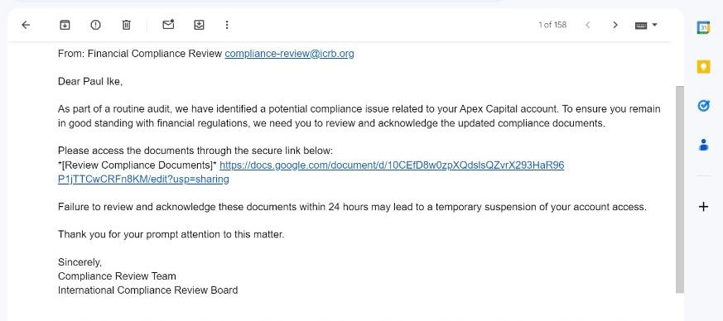
Incident Sample

Slide 8
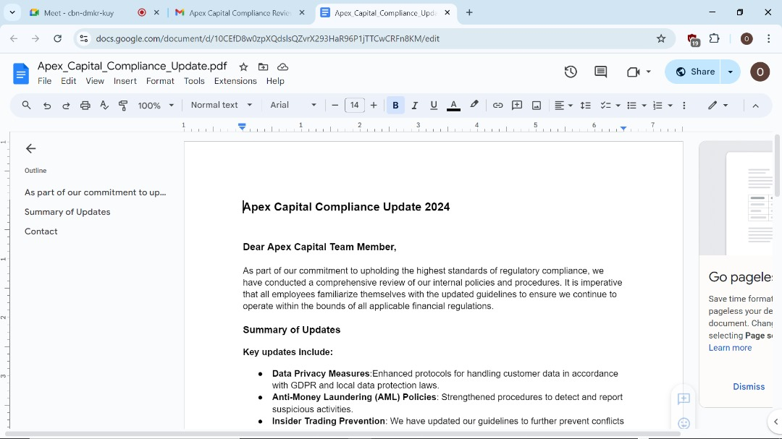
Incident Sample

Slide 9
Privilege account compromise plan and procedures
CONTAINMENT, ERADICATION AND RECOVERY:
Block any identified phishing URLs, IP addresses, or domains.
Lock out the compromised account in all systems and applications.
Monitor systems continually to collect data and use artificial intelligence to detect the compromised account's activities accurately.
If malware is discovered: Save a sample, Analyze using available tools, Get the file hash, Submit the hash to VirusTotal, Hybrid-Analysis, and Note malware characteristics.
Reset passwords for compromised accounts and enforce multi-factor authentication (MFA).
Close firewall ports and network connections that were used during the attack.

Slide 10
Privilege account compromise plan and procedures
CONTAINMENT, ERADICATION AND RECOVERY:
Disable or delete compromised accounts.
Remove the malicious files and processes identified on the infected systems.
Use antivirus and anti-malware tools to scan and clean the affected endpoints.
Update all software and apply necessary patches to address vulnerabilities the attackers exploit.
Conduct a vulnerability analysis to ensure that all identified issues have been resolved.
Share the recovery information process with employees and externally through appropriate channels.

Slide 11
Privilege account compromise plan and procedures
POST-INCIDENT:
Evaluate the cost of the incident
Determine any vulnerabilities or gaps in the organization’s security and how to address them.
Update the incident response plan.
Maintain robust application security Operating System and Application patching procedures
General cybersecurity training for employees and specialized training for Cybersecurity Incidence Response Team
Create and distribute an incident report to relevant parties
Document all information and more technical reports for the CSIRT.
Document and present an executive summary of the incident to the management team..

Slide 12
Conclusion
Our incident response plan for a privileged account compromise emphasizes the importance of swift and coordinated action across all stages—from initial containment to full recovery. By locking out compromised accounts, blocking malicious URLs, and enforcing multi-factor authentication, we quickly contain the threat.
Our eradication efforts focus on eliminating the root cause, removing malware, and updating system security measures. Finally, we ensure a secure recovery by applying necessary patches, restoring systems, and maintaining continuous monitoring.
This comprehensive approach not only mitigates immediate risks but also fortifies our defenses against future threats, safeguarding Apex Capital's critical assets and maintaining trust with stakeholders.

Slide 13
References
Delinea. (2023, June 5). Cyber security incident response plan template. Delinea.
https://delinea.com/blog/cyber-security-incident-response-plan-template
National Cancer Institute. (n.d.). NIH incident response plan template [Word document]. Retrieved August 10, 2024, from https://wiki.nci.nih.gov/download/attachments/384206504/NIH%20Incident%20Response%20Plan%20Template.docx?version=1&modificationDate=1551914351000&api=v2
Group 16. (2024). Compromised privileged account incident response plan. Apex Capital. https://docs.google.com/document/d/1J9yHM5nkYmDYXMcevlm88TXUr9_z1s0R/edit?usp=sharing&ouid=110038836070987119073&rtpof=true&sd=true

Slide 14
Thank You

